Slide 1
The Connected Society – a Transformation to the Baltic Smart Cities
13 June 2017

Slide 2
Agenda
UBC
Challenge
Baltic Smart City

Slide 3
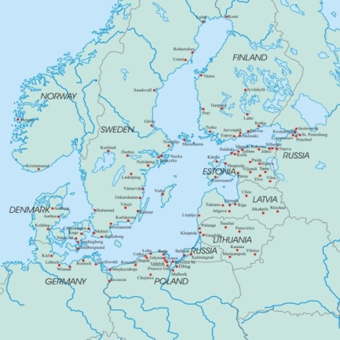
UBC
100MIO
Population
101
Member cities

Slide 4
Challenge
Globalization
Competition
Participation

Slide 5
Baltic Smart City
Focus
Cooperate
Innovate

